Slide 1
Software engineering (Undergraduate)
Chapter 10
software testing
Course Name
software engineering
CSC 3114
(Undergraduate)
Tonny kar

Slide 2
Software testing
Slide-2
Testing is the process of exercising a program with the specific intent of finding errors
prior to delivery to the end user
Software testability is simply how easily [a computer program] can be tested
Testing Shows
Error
Requirements Conformance
Performance
An indication of quality
MMH

Slide 3
Who tests the software?
Slide-3
Developer
  Understands the system but, will test "gently“ and, is driven by "delivery“
  Experiencing the software operation (known to the developer)
Independent tester
  Must learn about the system, but, will attempt to break it and, is driven by “quality”
  Exploring the software operation (unknown to the tester)
MMH

Slide 4
V & V
Slide-4
Validation refers to a different set of tasks that ensure that the software that has been built is traceable to customer requirements.
Verification refers to the set of tasks that ensure that software correctly implements a specific function/process.
Boehm states this another way:
  Validation: "Are we building the right product?“
  Verification: "Are we building the product right?"
MMH

Slide 5
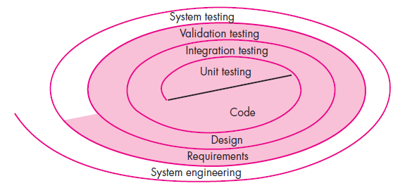
Testing strategy
Slide-5
MMH

Slide 6
Testing Strategy
Slide-6
We begin by ‘testing-in-the-small’ and move toward ‘testing-in-the-large’
For conventional software
  The module (component) is our initial focus
  Integration of modules follows
For OO software
  Our focus when “testing in the small” changes from an individual module
  (the conventional view) to an OO class that encompasses attributes and
  operations and implies communication and collaboration
MMH

Slide 7
Testing Strategic issues
Slide-7
Specify product requirements in a quantifiable manner long before testing commences
State testing objectives explicitly
Understand the users of the software and develop a profile for each user category
Develop a testing plan that emphasizes “rapid cycle testing”
Build “robust” software that is designed to test itself
Use effective technical reviews as a filter prior to testing; many errors will be eliminated before testing begins
Conduct technical reviews to assess the test strategy and test cases themselves
Develop a continuous improvement approach for the testing process
MMH

Slide 8
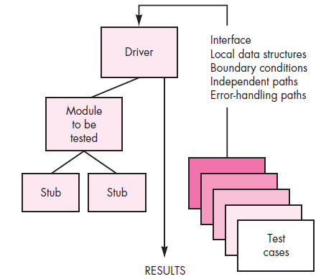
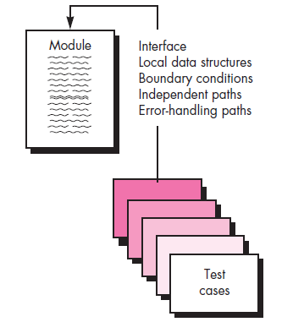
Unit testing
Slide-8
Tests a small software unit at a time, which is typically performed by the individual programmer who implemented the unit prior to Integration testing
Stub: it is the behavior of the lower-level modules that are under development and not yet integrated to other modules
MMH

Slide 9
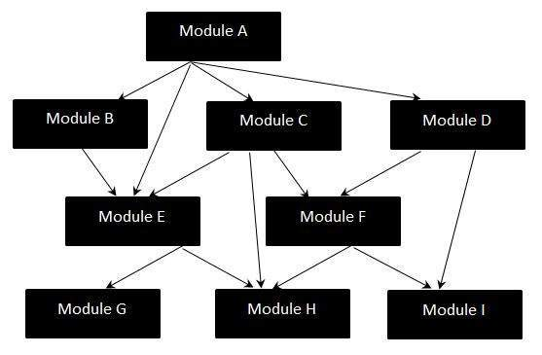
Integration testing strategies
Slide-9
System integration testing (SIT) is a systematic technique for assembling a software system while conducting tests to uncover errors associated with interfacing the modules
the “big bang” approach: Big Bang Integration Testing is an integration testing strategy where all units are linked at once, resulting in a complete system.
MMH

Slide 10
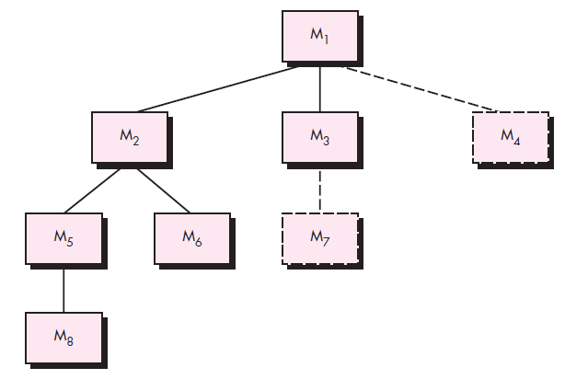
Top-down Integration
Slide-10
top module is tested with stubs down to the bottom
stubs are replaced one at
a time, "depth first"
as new modules are integrated,
some subset of tests is re-run
MMH

Slide 11
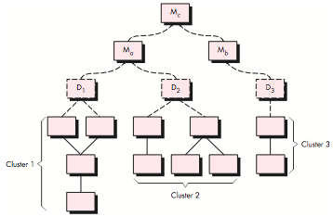
Bottom-up Integration
Slide-11
MMH

Slide 12
Regression testing
Slide-12
Regression testing is the re-execution of some subset of tests that have already been conducted to ensure that changes have not propagated unintended side effects
Whenever software is corrected, some aspect of the software configuration (the program, its documentation, or the data that support it) is changed.
Regression testing helps to ensure that changes (due to testing or for other reasons) do not introduce unintended behavior or additional errors.
Regression testing may be conducted manually, by re- executing a subset of all test cases or using automated capture/playback tools.
MMH

Slide 13
smoke testing
Slide-13
Smoke testing steps:
Software components that have been translated into code are integrated into a “daily build”
  A build includes all data files, libraries, reusable modules, and engineered components that are required to implement one or more product functions.
A series of tests is designed to expose errors that will keep the build from properly performing
its function.
  The intent should be to uncover “show stopper” errors that have the highest likelihood of throwing the software project behind schedule.
The build is integrated with other builds and the entire product (in its current form is smoke tested daily.
  The integration approach may be top down or bottom up.
MMH

Slide 14
Object-oriented testing
Slide-14
Class testing is the equivalent of unit testing
  Operations within the class are tested
  The state behavior of the class is examined
Integration applied three different strategies
  Thread-based testing—integrates the set of classes required to respond one input or event
  Use-based testing—integrates the set of classes required to respond to one use case
  Cluster testing—integrates the set of classes required to demonstrate one collaboration
MMH

Slide 15
Higher order testing
Slide-15
System testing: focus is on system integration (e.g. hardware integration, OS compatibility)
Alpha/Beta testing: Alpha testing is simulated or actual operational testing by potential users
or an independent test team at the developers' site. Alpha testing is often employed for off-the-shelf software as a form of internal acceptance testing, before the software goes to beta testing by users
Recovery testing: forces the software to fail in a variety of ways and verifies that recovery
is properly performed
Security testing: verifies that protection mechanisms built into a system will, in fact, protect it
from improper penetration
Stress testing: executes a system in a manner that demands resources in abnormal quantity,
frequency, or volume
Performance Testing: test the run-time performance of software within the context of an
integrated system (e.g. time required to response a request, compliance with operational constraints)
MMH

Slide 16
Debugging
Slide-16
In many cases, the non-corresponding data are a symptom of an underlying cause as yet hidden error
The debugging process attempts to match symptom with cause, thereby leading to error correction
symptom may disappear when another problem is fixed
cause may be due to a combination of non-errors
cause may be due to a system or compiler error
cause may be due to assumptions that everyone believes
MMH

Slide 17
Debugging techniques
Slide-17
Brute force testing
  most common; but least efficient
  memory dumps are taken, run-time traces are invoked, and the program is loaded with output statements (Dynamic Testing)
Backtracking
  common debugging approach that can be used successfully in small programs
  source code is traced backward (manually) until the cause is found
Cause elimination
  a “cause hypothesis” is devised
  if initial tests indicate that a particular cause hypothesis shows promise, data are refined in an attempt to isolate the bug (c/a-b where the possibility of a-b is zero)
MMH

Slide 18
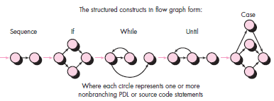
Basis-path testing
Slide-18
The basis path method enables the test-case designer to derive a logical complexity measure of a procedural design and use this measure as a guide for defining a basis set
of execution paths
McCabe views a program
as a directed graph in which
lines of program statements
are represented by nodes and
the flow of control between the
statements is represented
by the edges
Flow Graph
MMH

Slide 19
Independent program paths
Slide-19
Path 1: 1-11
Path 2: 1-2-3-4-5-10-1-11
Path 3: 1-2-3-6-8-9-10-1-11
Path 4: 1-2-3-6-7-9-10-1-11
Note that each new path introduces a new edge.
The path 1-2-3-4-5-10-1-2-3-6-8-9-10-1-11 is not considered to be an independent path because it is simply a combination of already specified paths and does not traverse any new edges.
How do you know how many paths to look for?
The computation of cyclomatic complexity provides the answer
MMH

Slide 20
Cyclomatic complexity
Slide-20
Cyclomatic complexity is a software metric that provides a quantitative measure of the logical complexity of a program. Complexity is computed in one of three ways:
The number of independent paths
The number of regions of the flow graph corresponds to the cyclomatic complexity.
(in the previous example = 4)
Cyclomatic complexity V(G) for a flow graph G is defined as V(G) = E - N + 2
(in the previous example 11 -9 + 2 = 4)
  where E is the number of flow graph edges and N is the number of flow graph nodes.
Cyclomatic complexity V(G) for a flow graph G is also defined as V(G) = P + 1
(in the previous example 3 + 1 = 4) [condition: 1; 2,3; 6]
  where P is the number of predicate nodes (containing a condition) contained in the flow graph G
MMH

Slide 21
White-box testing
Slide-21
Using white-box testing methods, you can derive test cases that
guarantee that all independent paths within a module have been exercised at least once,
exercise all logical decisions on their true and false sides,
execute all loops at their boundaries and within their operational bounds, and
exercise internal data structures to ensure their validity.
MMH

Slide 22
Black-box testing
Slide-22
Focuses on the functional requirements of the software
Black-box testing attempts to find errors in the following categories:
incorrect or missing functions
interface errors
errors in external database access (accessibility)
behavior or performance errors
initialization and termination errors
MMH

Slide 23
references
Slide - 23
R.S. Pressman & Associates, Inc. (2010). Software Engineering: A Practitioner’s Approach.
Kelly, J. C., Sherif, J. S., & Hops, J. (1992). An analysis of defect densities found during software inspections. Journal of Systems and Software, 17(2), 111-117.
Bhandari, I., Halliday, M. J., Chaar, J., Chillarege, R., Jones, K., Atkinson, J. S., & Yonezawa, M. (1994).
In-process improvement through defect data interpretation. IBM Systems Journal, 33(1), 182-214.

